Slide 1
DATA SCIENCE
10 WEEK PART TIME COURSE
Week 1c - Pandas

Slide 2
AGENDA
Using Data Science Packages
What are the steps in a Data Science project?
Installing and using pandas (pre-processing)
A first data science project
Discussion
Course Projects
Homework

Slide 3
USING DATA SCIENCE PACKAGES (What software will we be using?)
DATA SCIENCE PART TIME COURSE

Slide 4


WHY CHOOSE PYTHON?
Batteries Included: Large collection of built in libraries e.g. SciKit, Pandas, Theano, etc
Simple and clean syntax
General purpose language: lots of people outside of data science will be able to work with it

Slide 5
WHAT ARE PACKAGES?
Packages are libraries of code written to solve a particular set of problems
In Python there are many related to data science including Pandas, SciKit Learn, Numpy
These are installed and managed with PIP (Pip Installs Packages)
pip install some-package-name

Slide 6
WHAT PACKAGES DO YOU NEED?
pandas: manipulate data
SciPy / NumPy: scientific computing and numerical calculations
scikit-learn: use machine learning methods
matplotlib: visualise data
statsmodels: perform statistical tests
Beautiful Soup: read in XML and HTML data
iPython: interactive programming

Slide 7
WHAT ARE THE STEPS IN A
DATA SCIENCE PROJECT?
DATA SCIENCE PART TIME COURSE

Slide 8
Step 0.
Be as lazy as possible
Try to find pre-packaged software
This is why we are using python and python data science libraries.

Slide 9
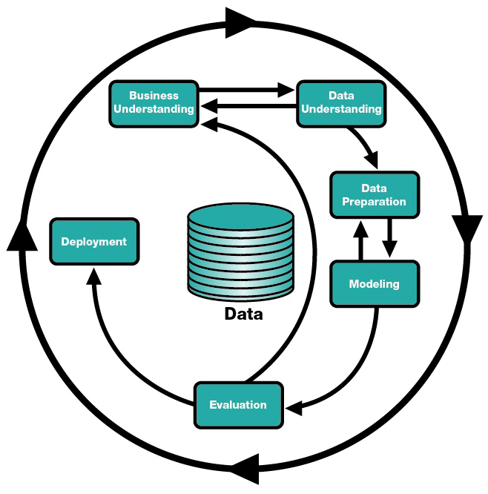

Slide 10
Predictive Modelling Workflow
Acquire
Preprocess
Learn
Evaluate
Predict

Slide 11
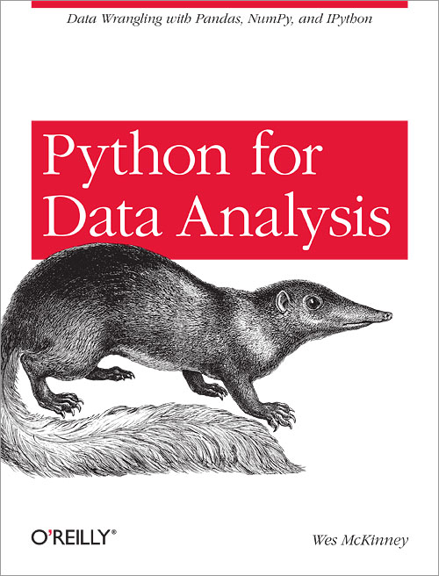
Pandas (Python Data Analysis Library)
Reads Excel, CSV, databases, HDF5
Efficient storage and retrieval
Some SQL-like selection, grouping tools
Summarises data
Interpolates time series data
pip install pandas
or
apt-get install python-pandas
or
use anaconda

Slide 12

Pandas uses some hairy Python
 | Reminder:
a+b | a.__class__.__add__(b)
a[b] | a.__class__.__getitem(b)
a.b | a.__class__.__getattr(b)
a<b | a.__class__.__lt__(b) which might or might not be a boolean

Slide 13
Pandas Data Types
Series | 1-dimensional data set | Series([1,2,3,4,5])
DataFrame | Row-column data set | DataFrame(data={ ‘A’: series1, ‘B’: series2})
Panel | 3-dimensional data set | Panel(. . . )
e.g.
import pandas as pd
s = pd.Series([“Central”, “Chatswood”, “Redfern”])

Slide 14
Series
Have an index
Automatically created with [0,1,2…] unless index=… is used
The index doesn’t have to be numeric
Can be retrieved by index, index ranges
Can be added, multiplied, subtracted
Done by index
Copes with missing data
Can be compared against numbers
Returns a shorter Series
Which can be used as an index, or bool’d with & and |
Interesting functions and Attributes:
mean(), median(), max(), tshift(), describe(), dtype
idxmin(), idxmax(), value_counts(), isnull(), notnull()

Slide 15
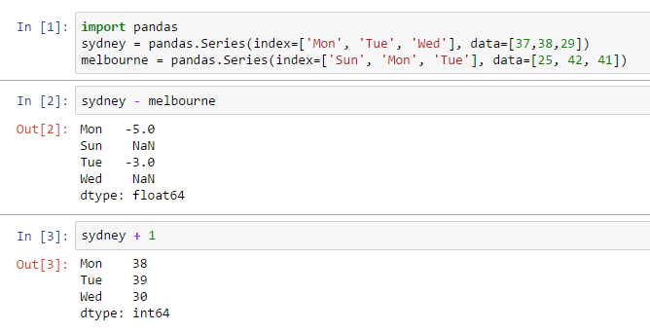
Example code
Add series together
Add a number to a series

Slide 16
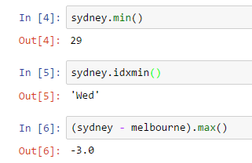
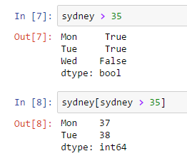
More Pandas series examples
Which index has the minimum number?
When you add two series together, the result is a series
When you compare, you get a list of booleans
If you index by a list of booleans, you get just the true ones

Slide 17
Dataframes
Often created by reading from CSV / Excel with pandas.read_csv()
See also read_table(), read_excel()…
Sometimes from a dictionary of Series
Have an index
Autogenerated from underlying Series if not specified
Drops other data if it is specified

Slide 18
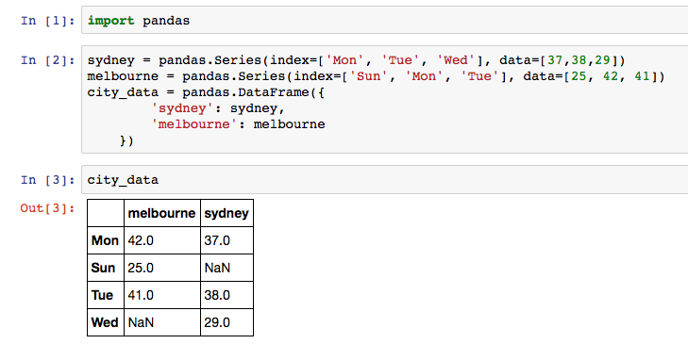
Create a dataframe with a
dictionary of Series

Slide 19
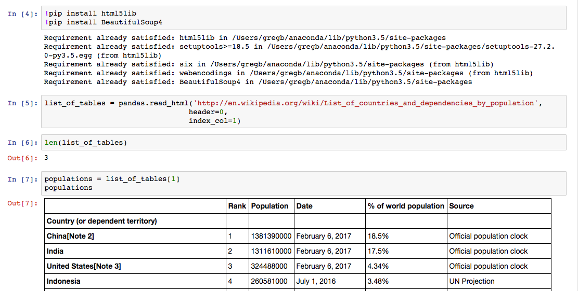
Some necessary requirements
Create a Dataframe by scraping the web

Slide 20
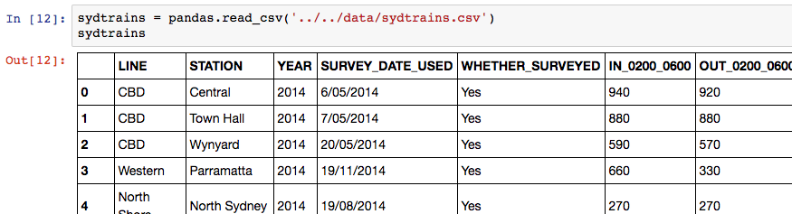
Create a Dataframe by reading a CSV file
It’s up two folders and then down into the “data” folder

Slide 21
Selecting data in a dataframe
df[ some boolean series ] – returns a dataframe with just the rows where the series has a “True”
df['one column'] – returns the column called “one column” as a Series
df.one_column – also returns the column called “one_column” as a series (but only works if there are no spaces or funny characters in the column name)
df[ ['columnA', 'columnB', 'columnC' ] ] – returns a dataframe with just those three columns
df.loc['some value'] – returns (as a series) the row in the dataframe where the index is “some value”

Slide 22
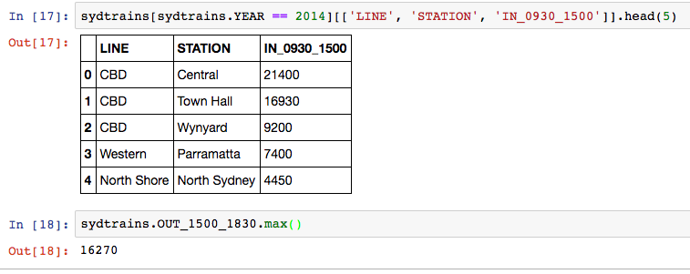
Boolean series
List of column names
Dataframe
Calling a
dataframe method
Calling a series method
Column title

Slide 23
We do this all the time…
Add a column from something else:
df["total"] = df.columnA + columnB
df["is_yes"] = (
df.columnA.str.contains("yes")
|
df.columnA.str.contains("ok")
)

Slide 24
Useful functions and attributes for DataFrames
shape
isnull(), notnull()
head(), tail(), sample()
min(), max(), sum(), mean(), describe(),
idxmin(), idxmax(), value_counts()
duplicated(columnname)
groupby([columnname]) returns a DataFrameGroupBy

Slide 25
First Data Science Project
DATA SCIENCE PART TIME COURSE

Slide 26
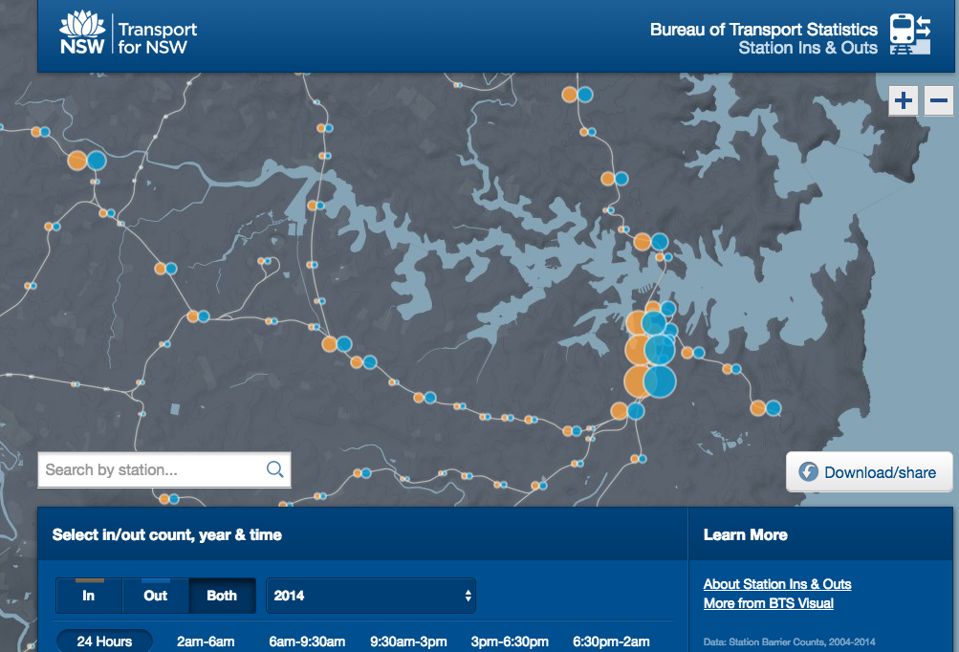
SYDNEY TRANSPORT DATA
http://visual.bts.nsw.gov.au/barrier/

Slide 27
Train Station Barrier Counts 2004-2014.csv
CBD,Central,2014,6/05/2014,Yes,940,920,10390,42070,21400,30150,45370,16270,19010,7700,"97,110","97,110",1,101
CBD,Town Hall,2014,7/05/2014,Yes,880,880,6380,43210,16930,23550,43670,15270,21760,6720,"89,620","89,620",2,102
CBD,Wynyard,2014,20/05/2014,Yes,590,570,4710,39620,9200,11180,35010,6510,10690,2330,"60,200","60,200",3,103
Western,Parramatta,2014,19/11/2014,Yes,660,330,7790,13700,7400,7020,14960,8660,4150,5260,"34,960","34,960",4,905
North Shore,North Sydney,2014,19/08/2014,Yes,270,270,2340,18340,4450,5590,17760,3050,3790,1360,"28,610","28,610",5,1402
CBD,Redfern,2014,1/05/2014,Yes,250,250,3910,10690,5350,8170,12510,4250,3660,2320,"25,680","25,680",6,108
North Shore,Chatswood,2014,19/08/2014,Yes,210,200,5030,8200,4710,4930,9430,6000,2820,2860,"22,200","22,200",7,1407
Eastern Suburbs,Bondi Junction,2014,2/09/2014,Yes,210,210,10150,4350,4370,4600,5240,8330,1910,4380,"21,880","21,880",8,203
Inner West,Strathfield,2014,9/09/2014,Yes,190,190,7900,4050,4980,3950,5540,7230,2100,5280,"20,710","20,710",9,1110
CBD,Circular Quay,2014,22/05/2014,Yes,200,200,2110,8750,4340,6710,9910,3380,4070,1600,"20,630","20,630",10,104
CBD,Martin Place,2014,27/05/2014,Yes,200,190,590,14250,2900,3420,12340,1790,4600,970,"20,630","20,630",10,107
Illawarra,Hurstville,2014,28/05/2014,Yes,160,160,7790,2200,5230,4180,3840,7450,1270,4290,"18,290","18,290",12,310
North Shore,St Leonards,2014,27/05/2014,Yes,170,170,3420,8900,3090,3310,8780,3230,2130,1990,"17,590","17,590",13,1405
Western,Blacktown,2014,14/10/2014,Yes,190,210,6460,3370,4270,3450,4600,7090,1040,2450,"16,560","16,560",14,911
Inner West,Burwood,2014,9/09/2014,Yes,140,140,4850,2930,4470,3670,4020,5060,1510,3190,"14,990","14,990",15,1109
Eastern Suburbs,Kings Cross,2014,3/09/2013,No,120,120,3690,3820,3110,2670,4400,3640,1550,2620,"12,870","12,870",16,201
North Shore,Hornsby,2014,14/05/2014,Yes,210,100,5550,2260,3060,2390,2750,5200,680,2290,"12,250","12,250",17,1417
Inner West,Ashfield,2014,4/09/2013,No,100,100,5090,2010,2690,2220,2500,4500,820,2370,"11,200","11,200",18,1107
Illawarra,Kogarah,2014,19/06/2014,Yes,90,100,4000,2970,3150,2320,3210,3450,650,2260,"11,100","11,100",19,307
South,Lidcombe,2014,5/06/2014,Yes,100,100,4570,1620,2870,2210,2550,3900,820,3080,"10,910","10,910",20,702
Western,Auburn,2014,19/11/2014,Yes,130,60,3880,1790,3220,2900,2700,3890,960,2260,"10,890","10,890",21,901
CBD,Museum,2014,22/05/2014,Yes,100,100,800,6290,2220,2340,5980,1230,1760,910,"10,860","10,860",22,106
Northern via Strathfield,Epping,2014,21/05/2014,Yes,170,90,5700,1580,2130,1600,1970,4920,600,2380,"10,570","10,570",23,1208
Northern via Macquarie Park,Macquarie University,2014,21/05/2014,Yes,100,100,1310,3220,2570,3940,4530,1970,1580,860,"10,090","10,090",24,1303
CBD,St James,2014,27/05/2014,Yes,100,90,780,5880,1900,2160,5630,1120,1440,580,"9,850","9,850",25,105
Illawarra,Rockdale,2014,28/05/2014,Yes,90,90,4660,780,2610,2170,1670,3770,610,2820,"9,640","9,640",26,306
South,Cabramatta,2014,11/06/2014,Yes,150,80,3780,1070,2760,2820,1750,3760,290,1000,"8,730","8,730",27,708
data/sydtrains.csv

Slide 28
FIND THE LEAST BUSY TRAIN STATION IN 2014?
We’ll use:
read_csv
idxmin

Slide 29
Other things you should know
Turn numbers into range categories:
pandas.qcut()
“Quartile Cut” / “Quintile Cut”
pandas.cut()
Equal-range cuts
Cross-join two DataFrames into another DataFrame
pandas.merge()
Uses index by default, can use on / left_on / right_on to join on other columns
Make an index of dates and times
pandas.date_range(start, end, periods, freq)
Can do business hours / timezones / etc.
Pandas can import Google Analytics, World Bank data, Yahoo Finance

Slide 30
Pandas Cheat Sheet in resources/week1
Pandas DataFrame Notes.pdf
Pandas_Cheat_Sheet.pdf
You don’t need to know everything[*]
[*] Unless you are a teenager

Slide 31

PANDAS LAB
DATA SCIENCE PART TIME COURSE
labs/Week 1/Lab 1 – Pandas.ipynb

Slide 32
HOMEWORK
Homework1.ipynb
Due next Friday
I will review within 7 days
Counts to letter of completion
(Will be easy)
DATA SCIENCE - Week 1 Day 2

